Slide 1
HEALTH INSURANCE MANAGEMENT SYSTEM

Slide 2
CONTENTS
Abstract
Introduction
Hardware and Software Requirements
ER Diagram
Schema Diagram
Snapshots
Conclusion
References

Slide 3
ABSTRACT
The project aims at providing a common platform for a Health Insurance company & common people to identify policies of interest and get information about all policies available. Health Insurance management system is a platform for digitizing Health Insurance buying process. Health Insurance plans like Individual, Family, Elderly etc. are available. Every individual wants to have the idle insurance plan with the best policy. The manual Health Insurance agency follows a lengthy and hectic process. People need to meet the agent in person, for checking the Policy details and also need to visit multiple times. It takes a long time to find the desired type of Insurance plan. Thus, this Project has proposed a Health Insurance management system to overcome this difficulty. Health Insurance management system can help you to get the best policy by just sitting at home or anywhere. People can buy their favourite insurance plan online just after a few clicks. In this system the admin can add the insurance plan for selling and users can buy the plan when needed. Users need to register and then login just by using credentials.

Slide 4
INTRODUCTION
Health insurance is insurance that covers the whole or a part of the risk of a person incurring medical expenses, spreading the risk over a large number of persons. By estimating the overall risk of health care and health system expenses over the risk pool, an insurer can develop a routine finance structure, such as a monthly premium or payroll tax, to provide the money to pay for the health care benefits specified in the insurance agreement. The benefit is administered by a central organization such as a government agency, private business, or not-for-profit entity. According to the Health Insurance Association of America, health insurance is defined as "coverage that provides for the payments of benefits as a result of sickness or injury. It includes insurance for losses from accident, medical expense, disability, or accidental death and dismemberment".

Slide 5
INTRODUCTION
Insurance is an agreement of compensation for specific possible future losses such as damage, illness or death in interchange for periodic payment. It is designed as a risk management system to protect the financial well-being of a person, company or other entities in the case of accidental loss. Agreeing to the terms of an insurance policy creates a contract between the insured and the insurer in exchange for payments from the insured called PREMIUM. The insurer agrees to pay the policy holder a sum of money upon the occurrence of a specific event. In most cases, the policy holder pays part of the loss called the DEDUCTIBLE and the insurer pays the rest. There are different types of insurance like life insurance, health insurance, car insurance, property insurance and travel insurance, etc. This project will cover all aspects of health insurance. Health insurance is a type of insurance that pays for both medical and surgical expenses gained by the insured. Health insurance can reimburse the insured for expenses incurred from illness or injury, or pay the care provider directly. It is often included in employer benefit packages as a means of fascinating quality employees. The cost of health insurance premiums is deductible to the payer, and benefits received are tax-free.

Slide 6
HARDWARE REQUIREMENTS
The hardware required for the development of this project is:
Processor - Intel core i5
Processor speed - 2.42 GHz
RAM - 8 GB
System Type - 64-bit operating system

Slide 7
SOFTWARE REQUIREMENTS
The software required for the development of this project is:
Software - Xampp
Operating System - Windows 10
Front End - HTML and CSS
Programming Language - SQL
Data Base Environment - MySQL
Server - Xampp

Slide 8
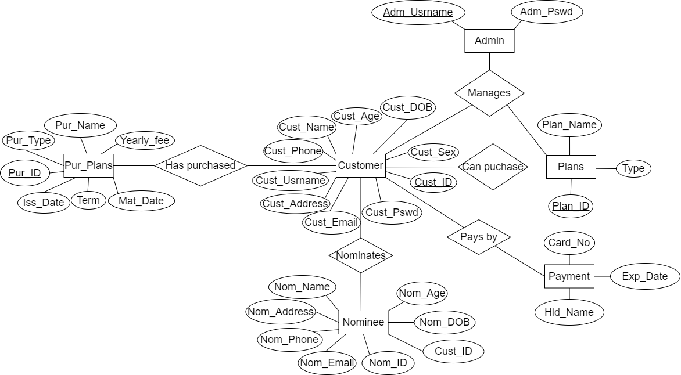
ER DIAGRAM

Slide 9
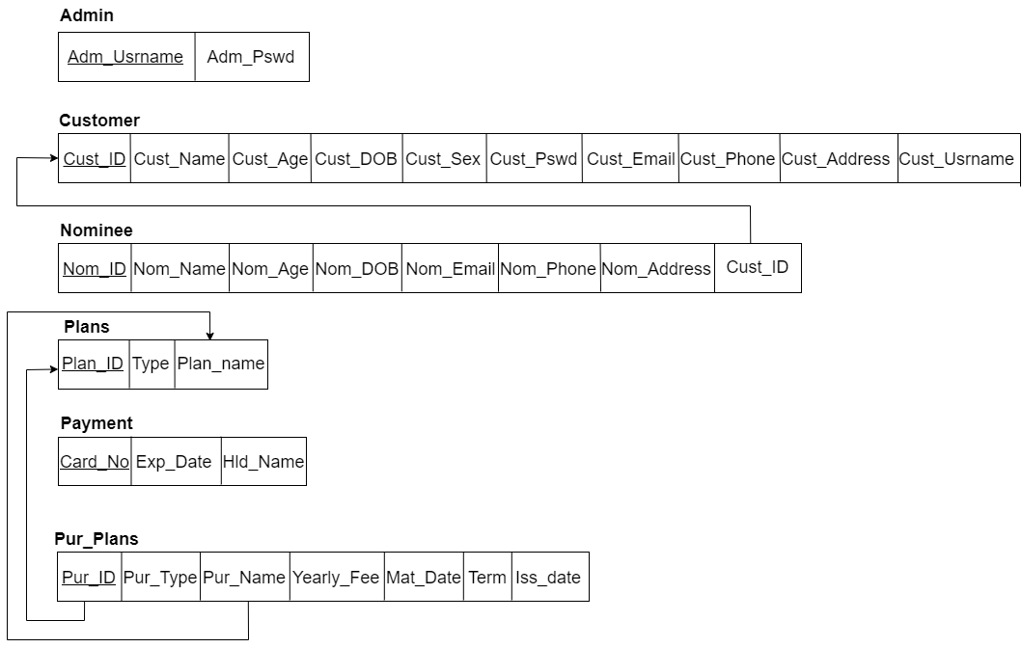
SCHEMAN DIAGRAM

Slide 10
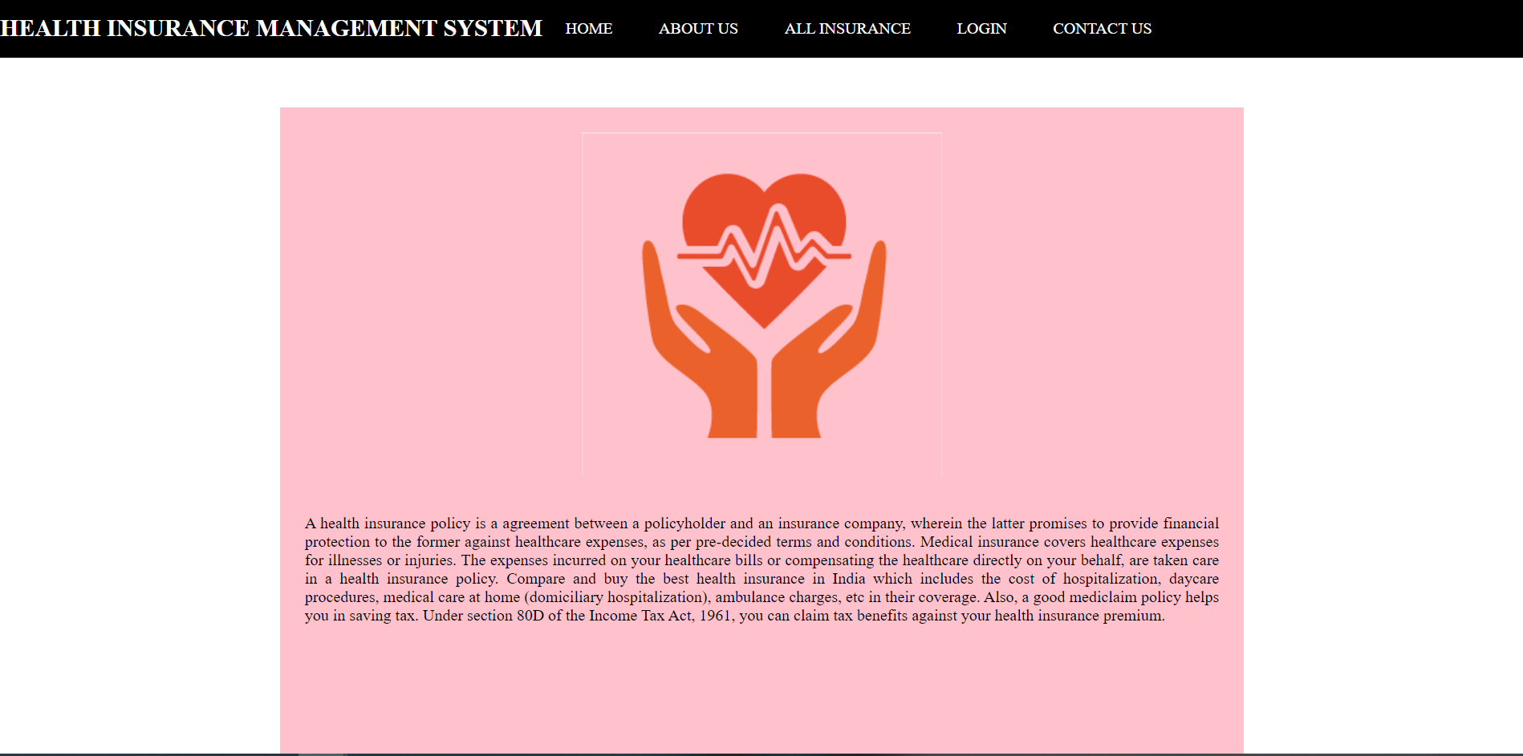
SNAPSHOTS
HOME PAGE

Slide 11

SNAPSHOTS
ABOUT US PAGE

Slide 12
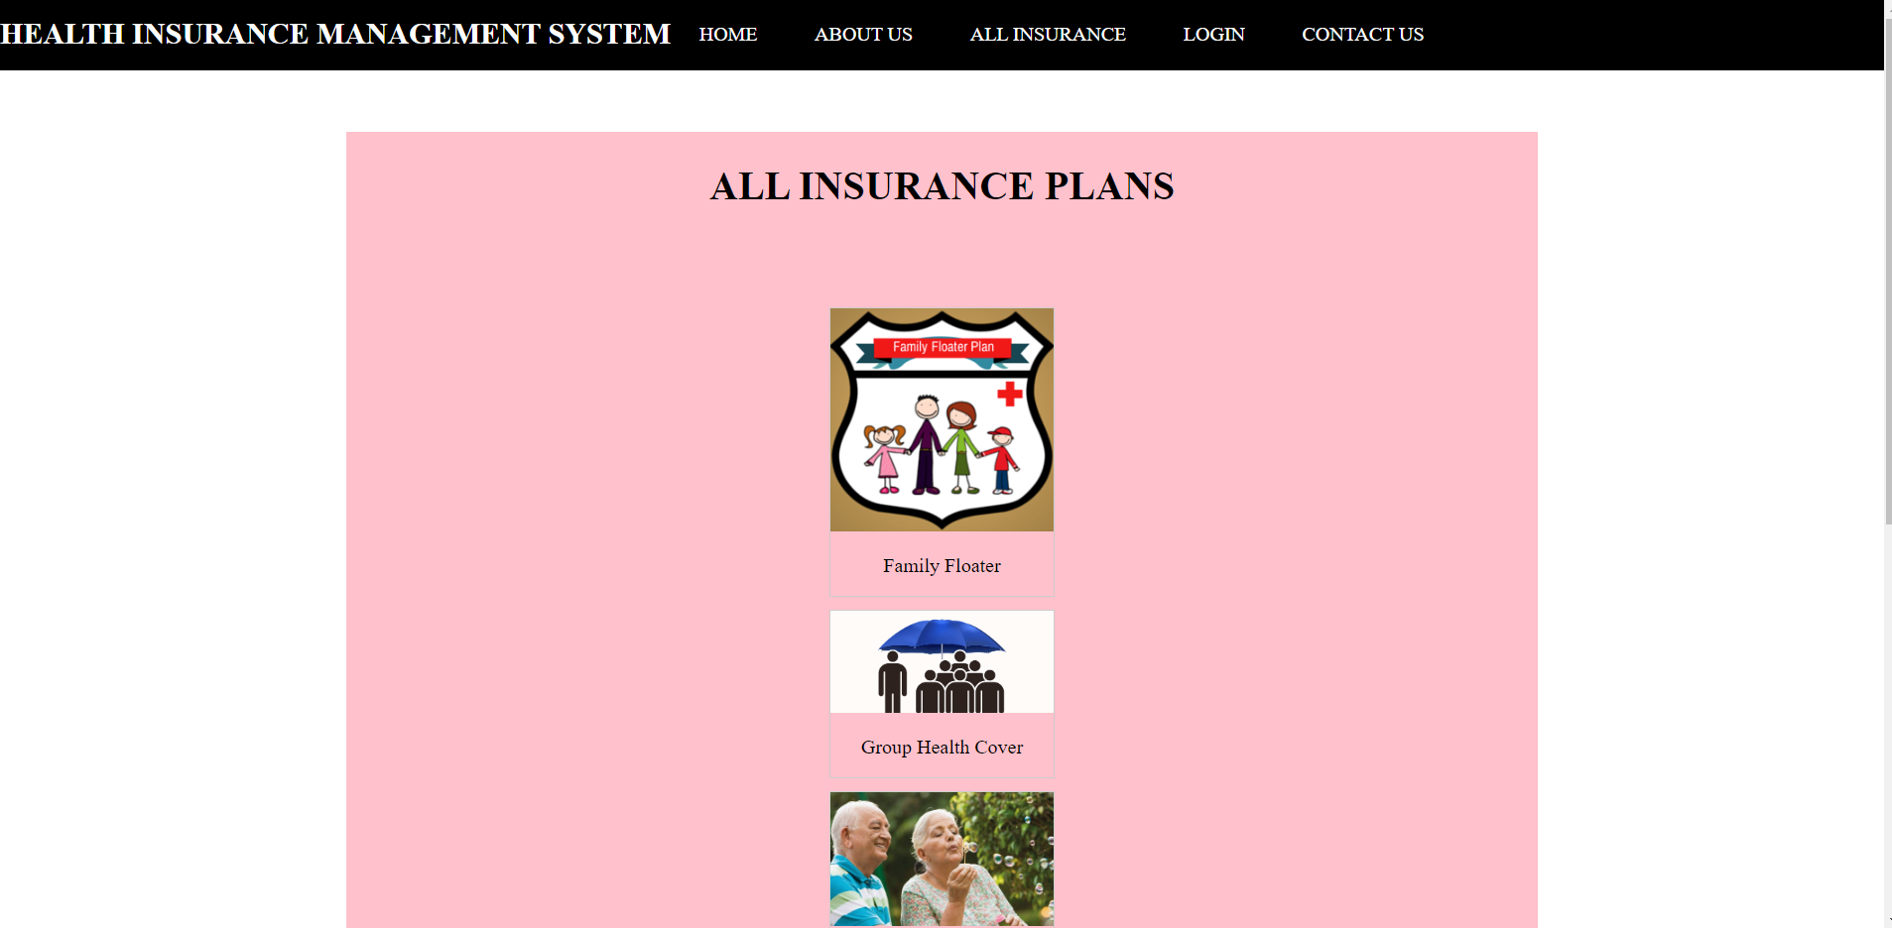
SNAPSHOTS
ALL INSURANCE PLANS PAGE

Slide 13
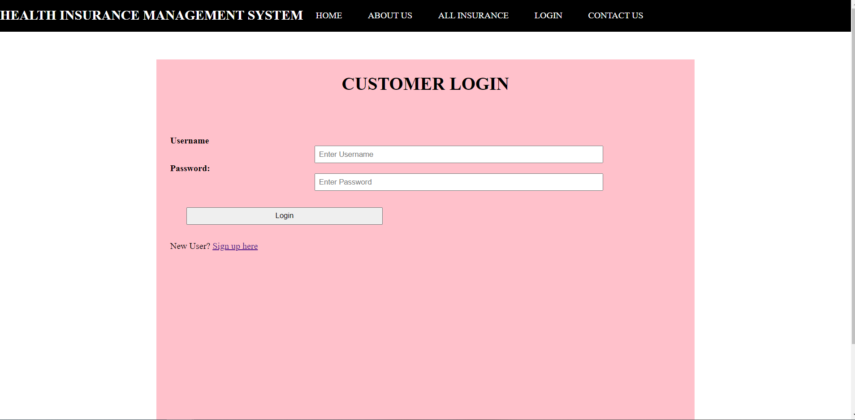
SNAPSHOTS
USER LOGIN PAGE

Slide 14
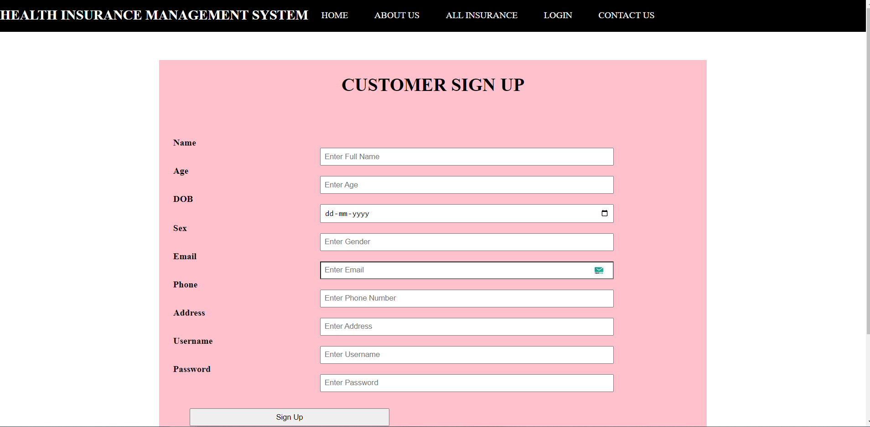
SNAPSHOTS
USER SIGNUP PAGE

Slide 15
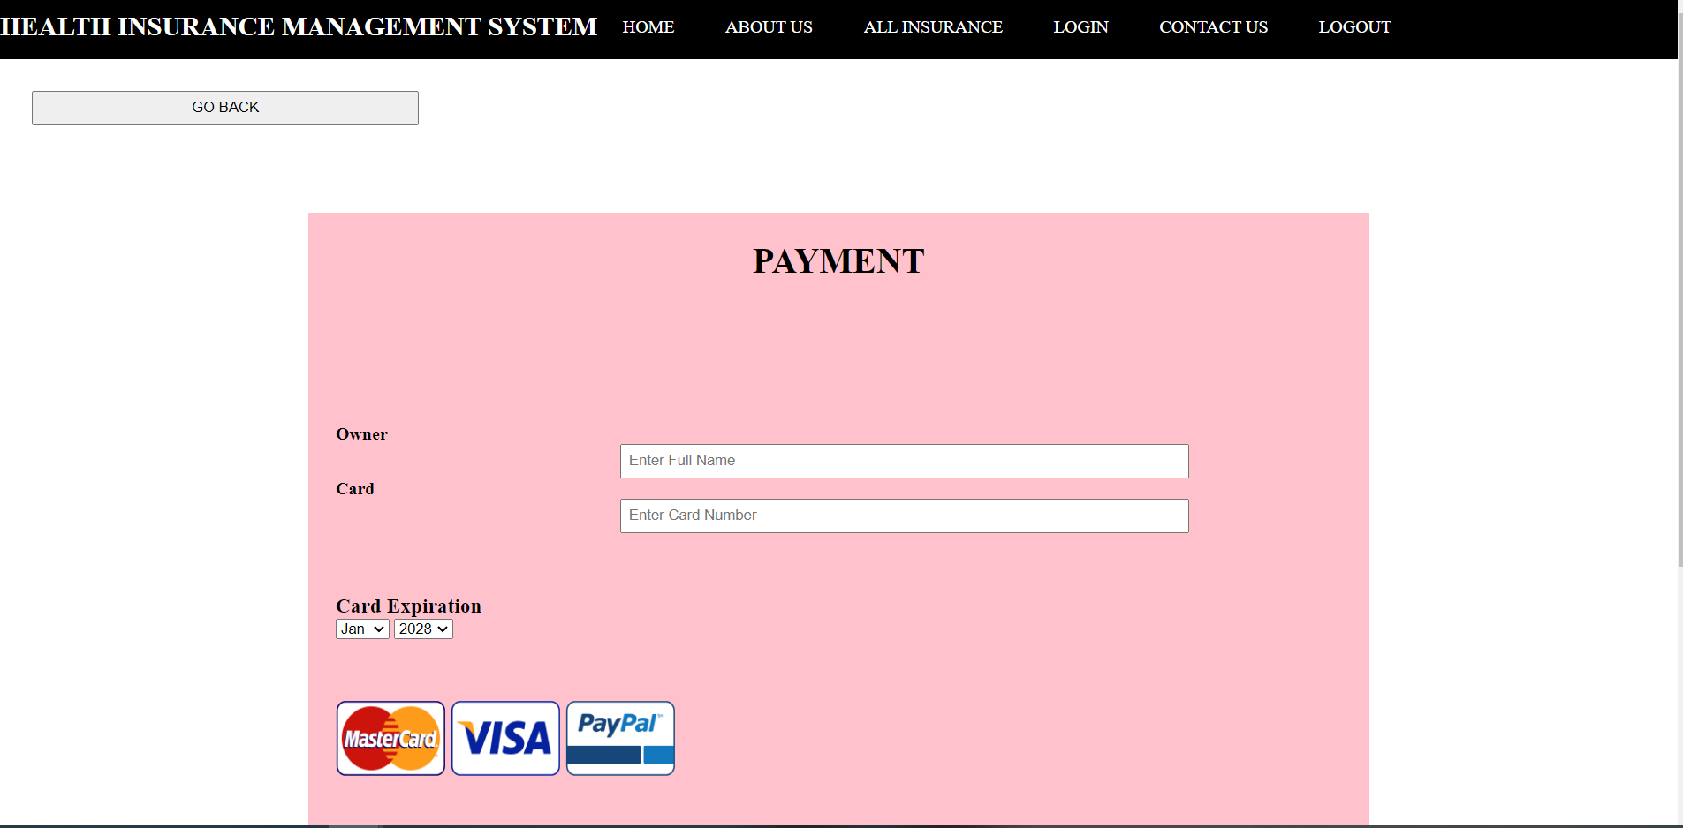
SNAPSHOTS
PAYMENT PAGE

Slide 16
CONCLUSION
The scope of health insurance is high with abundance of healthcare solutions provided by the private sector. Consumers prefer private healthcare sector because of better quality of care and more number of medical benefits and facilities. With all kinds of health insurance policies available, it allows all of us to have healthcare coverage. Insurance policies are available against all sorts of health risks, for all age groups and for all income levels. There is just a need to take a step ahead and make a choice according to personal healthcare needs.

Slide 17
REFERENCES
1. Fundamentals of database systems, Ramez Elmasri and S B Navathe, 7 th Edition, 2017,
Pearson
2. Database management systems, Ramakrishnan, and Gehrke, 3rd Edition, 2014, McGraw Hill.
3. Coronel, Morris, and Rob, Database Principles Fundamentals of Design, Implementation and
Management, Cengage Learning 2012.\
4. Silberschatz Korth and Sudharshan, Database System Concepts, 6 thEdition, McGraw Hill,
2013.
5. https://www.w3schools.com/
6. https://www.tutorialspoint.com/website_development/index.html

